Slide 1

Capstone Project-4 NETFLIX MOVIES AND TV SHOWS CLUSTERING
Team members:
Prince Jain
Rishabh Patidar
Vikas Shrivas

Slide 2

Point in touch:
Introduction
Problem Statement
Data Description
Null Value
Exploratory Data Analysis
Data Cleaning
Model Implementation
K- Means
Cluster Analysis

Slide 3

Introduction
Netflix is a company that manages a large collection of TV shows and movies, streaming it anytime via online. This business is profitable because users make a monthly payment to access the platform. However, customers
Netflix:
can cancel their subscriptions at any time.
Methodology:
Unsupervised Machine Learning (Clustering)
Netflix Movies and TV Shows
7787 rows and 12 columns
Data from last decade
Database:

Slide 4

Problem Statement
This dataset consists of tv shows and movies available on Netflix as of 2019. The dataset is collected from Flixable which is a third-party Netflix search engine.
In 2018, they released an interesting report which shows that the number of TV shows on Netflix has nearly tripled since 2010. The streaming service’s number of movies has decreased by more than 2,000 titles since 2010, while its number of TV shows has nearly tripled. It will be interesting to explore what all other insights can be obtained from the same dataset.
Integrating this dataset with other external datasets such as IMDB ratings, rotten tomatoes can also provide many interesting findings.
In this project, you are required to do
Exploratory Data Analysis
Understanding what type content is available in different countries
Is Netflix has increasingly focusing on TV rather than movies in recent years.
Clustering similar content by matching text-based features

Slide 5
Data Description
The data was collected from Flixable which is third party Netflix search engine. The dataset consists of movies and TV shows data till 2019. The dataset has 7787 rows of data.
The dataset consists of eleven textual columns and one numeric column.
Attribute Information :
show_id : Unique ID for every Movie / Tv Show
type : Identiﬁer - A Movie or TV Show
title : Title of the Movie / Tv Show
director : Director of the Movie
5. cast : Actors involved in the movie / show
6. country : Country where the movie / show was produced
7. date_added : Date it was added on Netﬂix
8. release_year : Actual Release year of the movie / show
9. rating : TV Rating of the movie / show
10. duration : Total Duration - in minutes or number of seasons
11. listed_in : Genre
12. description: The Summary description

Slide 6
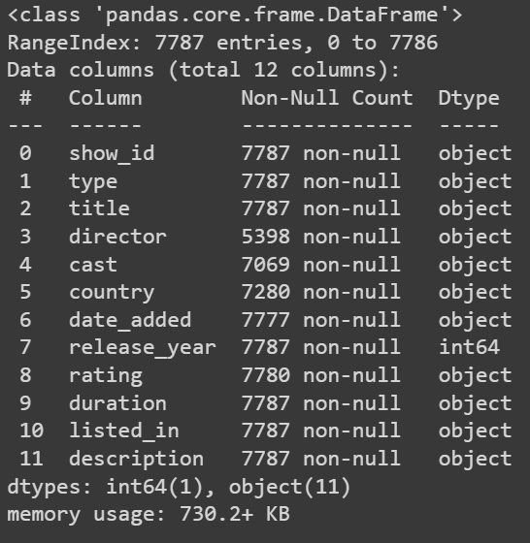
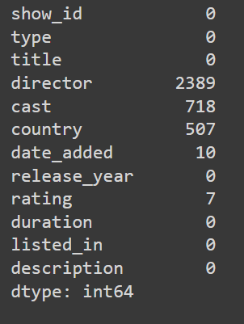

Null Value
Null Value Treatment:
● Director feature have more than 30.68% of null values. Filling null values by ‘unknown’.
● Country feature have 6.51% of null values. Filling null values by mode of feature.
● Cast feature have 9.22% of null values. Filling null values by ‘unknown’.
● Rating feature have 0.09% of null values. Filling null values by mode of feature.
● Date_added feature have 0.13% of null values. Dropping rows corresponding to null values.

Slide 7
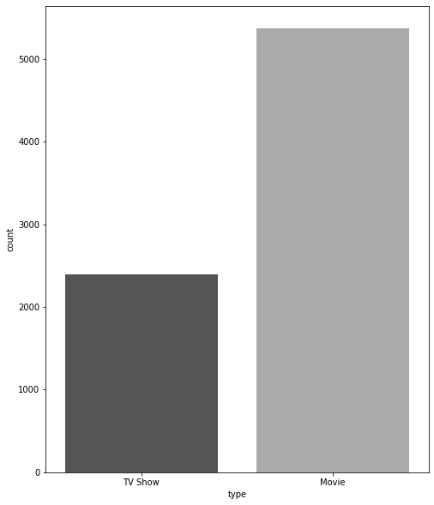
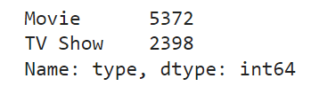
Exploratory Data Analysis
Type of content available on Netflix
•It is evident that there are more movies
on Netflix than TV shows.
•Netflix has 5372 movies, which is more
than double the quantity of TV shows.

Slide 8
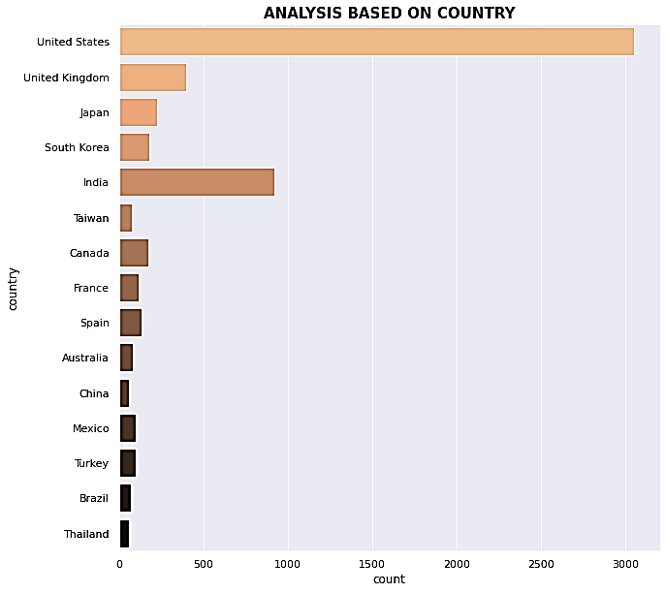
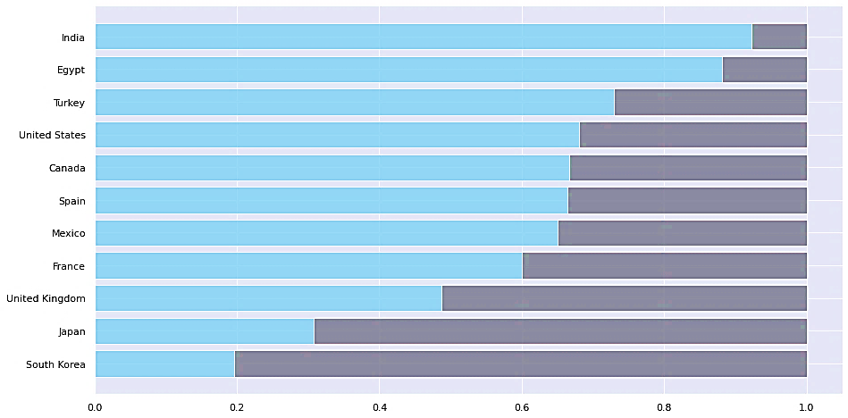
Exploratory Data Analysis
Analysis based on country:
India is the country having maximum numbers of movie on Netflix.
USA having maximum numbers of TV shows followed by India

Slide 9
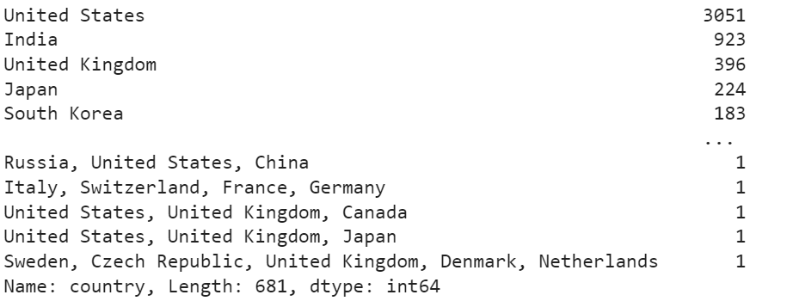
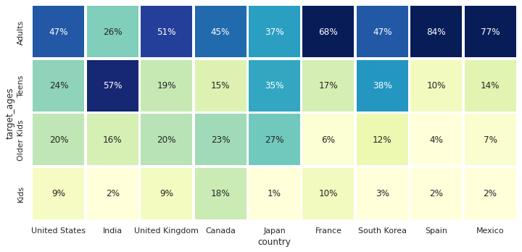
We group data into Four category and find that there are 57% uses are teens in India which maximum teens percentage. In Adults user Spain have 84% followed my Mexico which is 77%.
Exploratory Data Analysis
Analysis based on country: Heatmap

Slide 10
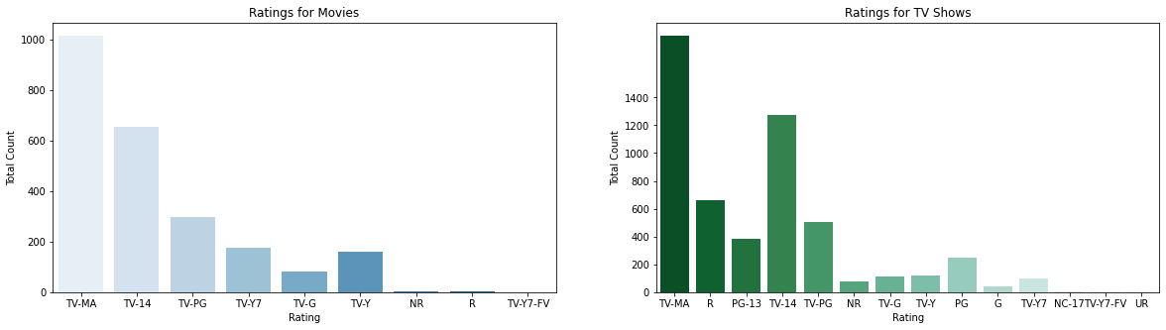
Exploratory Data Analysis
According to rating :
TV-MA has the highest number of ratings for tv shows i.e. adult ratings

Slide 11
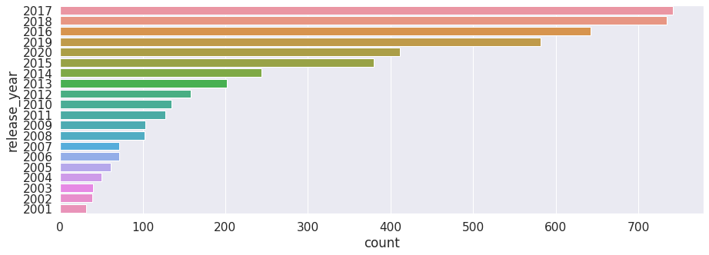
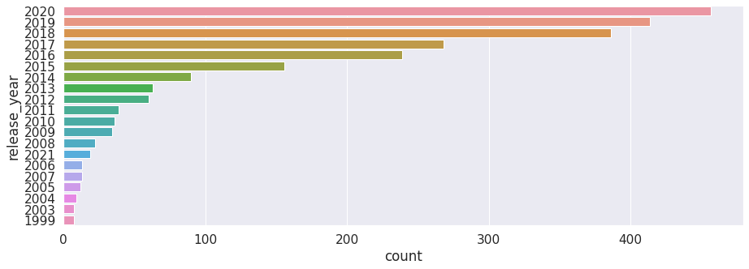
Exploratory Data Analysis
Releases over the year
TV shows.
Movies
Highest number of movies released in 2020.
The number of movies on Netflix is growing significantly faster than the number of TV shows.
We saw a huge increase in the number of movies and television episodes after 2015.
There is a significant drop in the number of movies and television episodes produced after 2020.
Highest number of movies released in 2017 and 2018

Slide 12
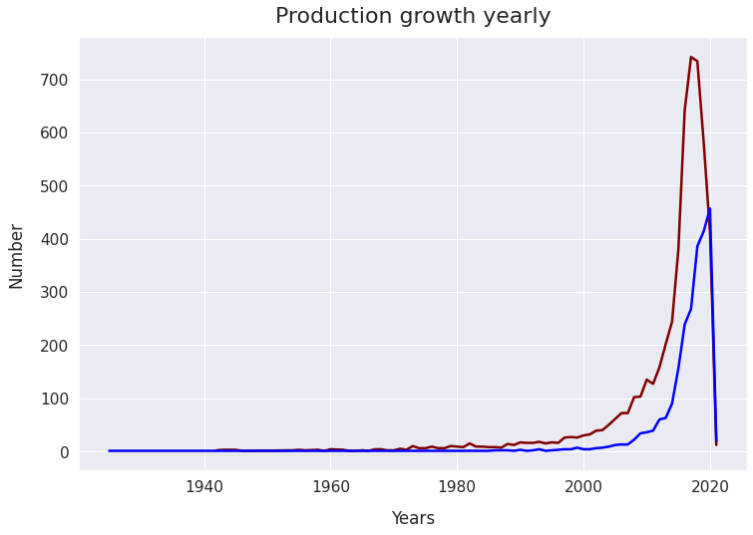
Exploratory Data Analysis
The number of release have significantly increased after 2015 and have dropped in 2021 because of Covid 19

Slide 13
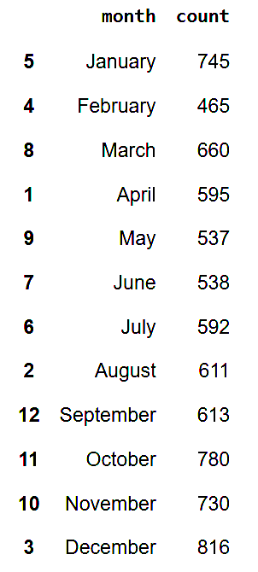
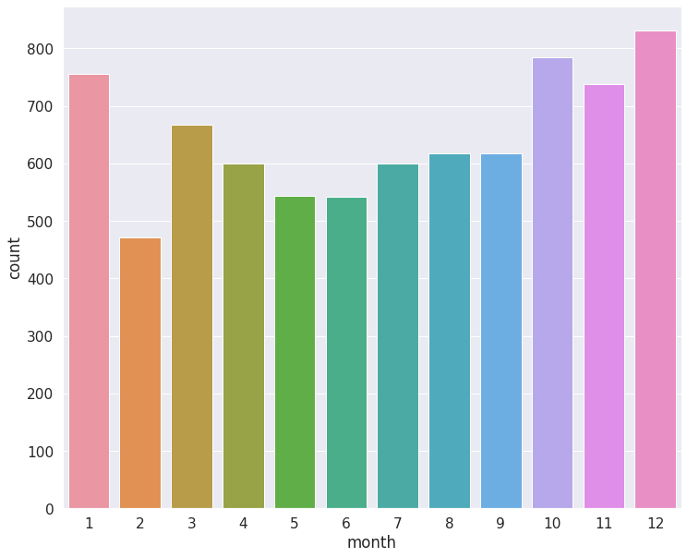
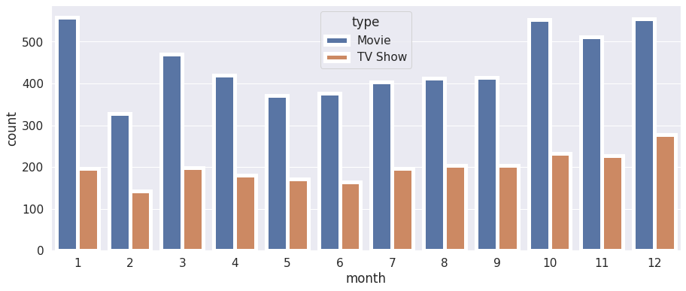
Exploratory Data Analysis
Month wise Analysis:
From October to January, maximum number of movies and TV shows were added.

Slide 14
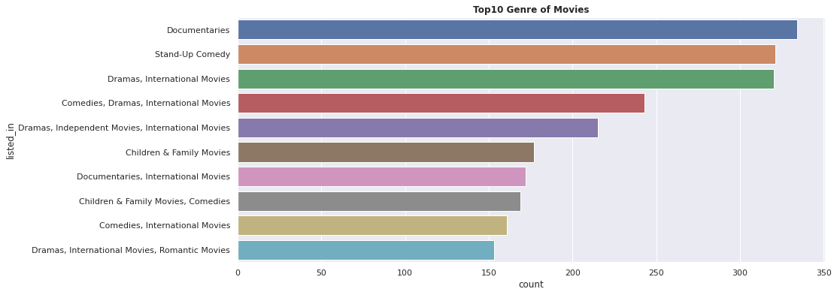
Exploratory Data Analysis
Documentaries are highest in numbers followed by standup comedy then Dramas

Slide 15
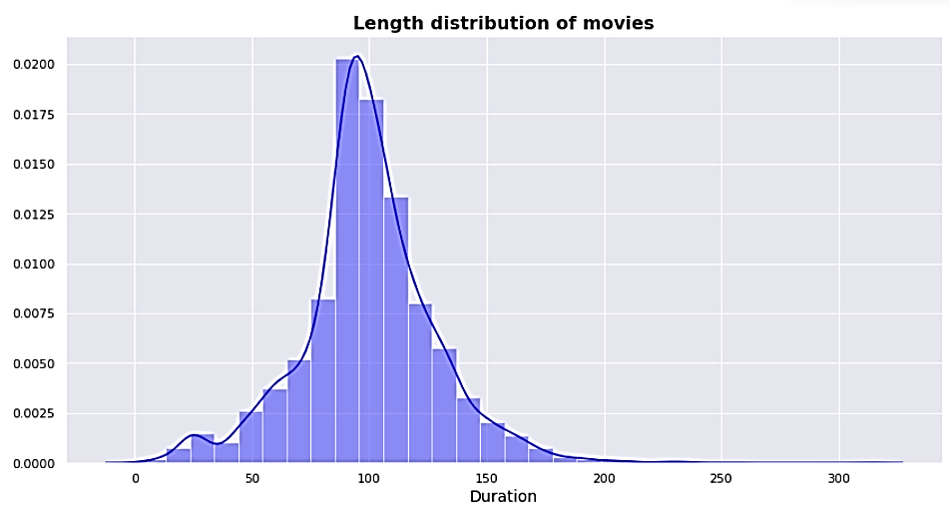
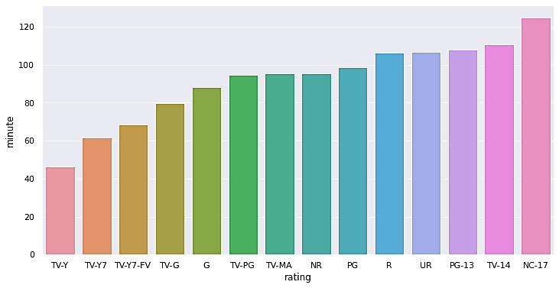
Duration distribution of Movies
Exploratory Data Analysis
Those movies that have a rating of NC-17 have the longest average duration.
When it comes to movies having a TV-Y rating, they have the shortest runtime on average
Maximum movies duration have 60min to 80 min.

Slide 16


Word Cloud for TV shows and Cast
TV Shows types
Which Cast to Choose?

Slide 17
Data Cleaning
Label Encoding
Lemmatisation- Lemmatization, unlike Stemming, reduces the inflected words properly ensuring that the root word belongs to the language. In Lemmatization root word is called Lemma. ... For example, runs, running, ran are all forms of the word run, therefore run is the lemma of all these words.
Removing Stop words - To remove stop words from a sentence, you can divide your text into words and then remove the word if it exits in the list of stop words provided by NLTK.
Min-max Scaling - For each value in a feature, MinMaxScaler subtracts the minimum value in
the feature and then divides by the range. It preserves shape of original distribution.

Slide 18
K - Means
To process the learning data, the K-means algorithm in data mining starts with a first group of randomly selected centroids, which are used as the beginning points for every cluster, and then performs iterative (repetitive) calculations to optimize the positions of the centroids
It halts creating and optimizing clusters when either:
The centroids have stabilized — there is no change in their values because the clustering has been successful.
The defined number of iterations has been achieved

Slide 19
K-Means Clustering
K-means algorithm is an iterative algorithm that tries to partition the dataset into K pre defined distinct non overlapping subgroups where each data point belongs to only one group.
1. Elbow Curve:
● The Elbow Curve is one of the most popular methods to determine this optimal value of k.
● The elbow curve uses the sum of squared distance (SSE)to choose an ideal value of k based on the distance between the data points and their assigned clusters.
2. Silhouette score :
● Silhouette score is used to evaluate the quality of clusters created using clustering algorithms such as K Means in terms of how well samples are clustered with other samples that are similar to each other.

Slide 20
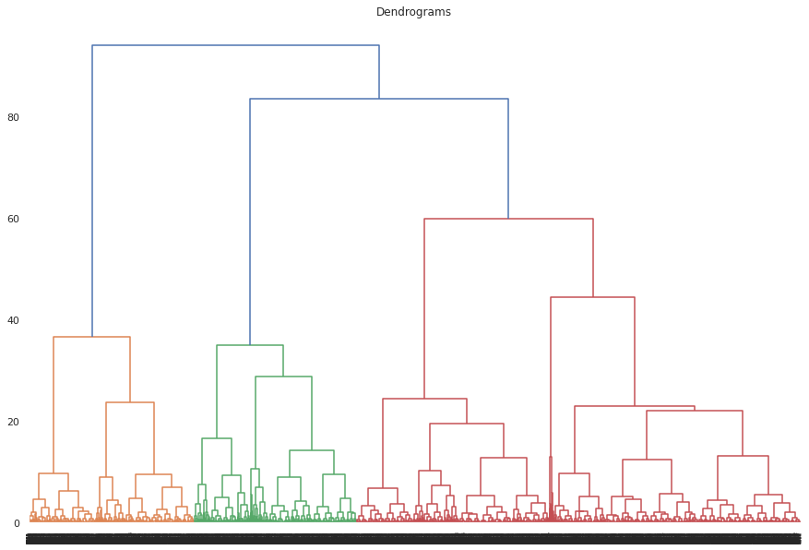
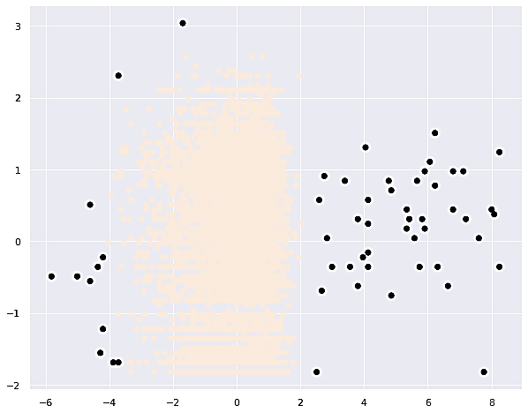
Model Implementation
1. Hierarchical Clustering
2. DBSCAN
Hierarchical clustering is the most popular and widely used method to analyze social network data. In this method, nodes are compared with one another based on their similarity.
DBSCAN stands for density-based spatial clustering of applications with noise. It is able to find arbitrary shaped clusters and clusters with noise (i.e. outliers).

Slide 21
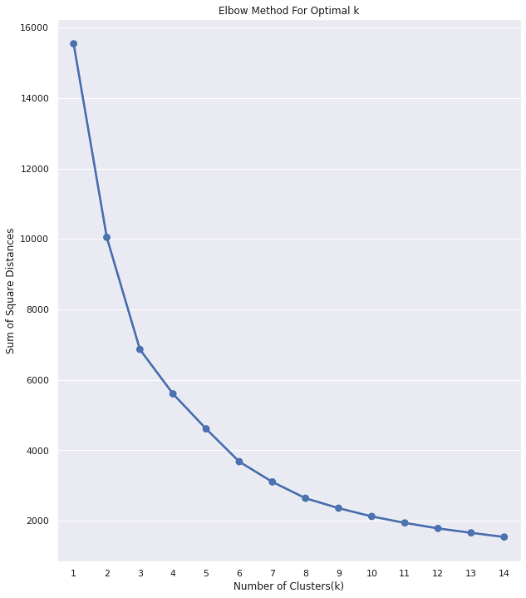
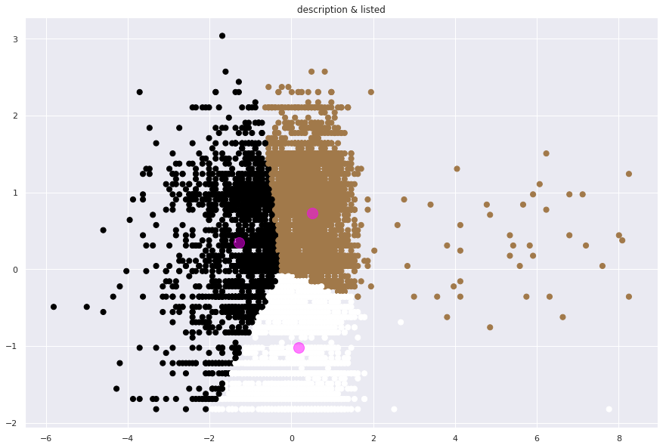
Model Implementation
4. K-means Clustering unsupervised ML algorithm
3. Elbow Method
In cluster analysis, the elbow method is a heuristic used in determining the number of clusters in a data set.
K-means clustering is an unsupervised technique that requires no labeled response for the given input data.

Slide 22
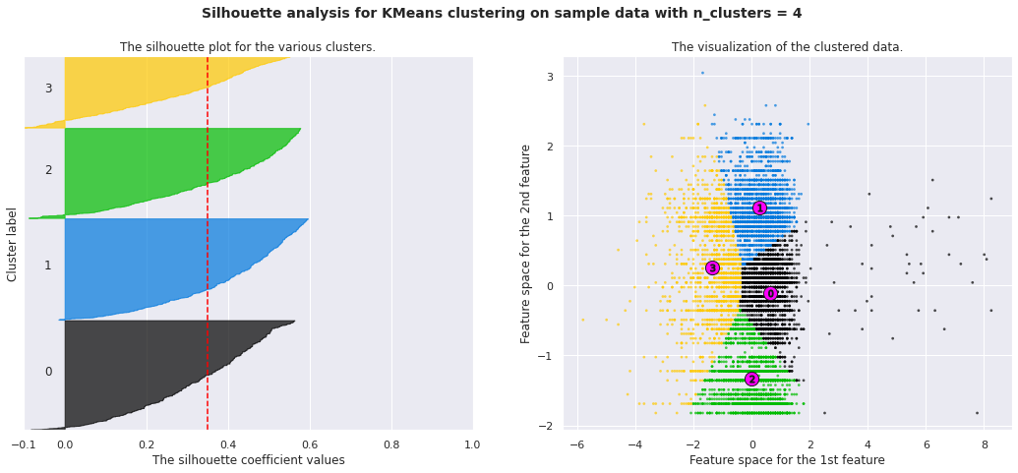
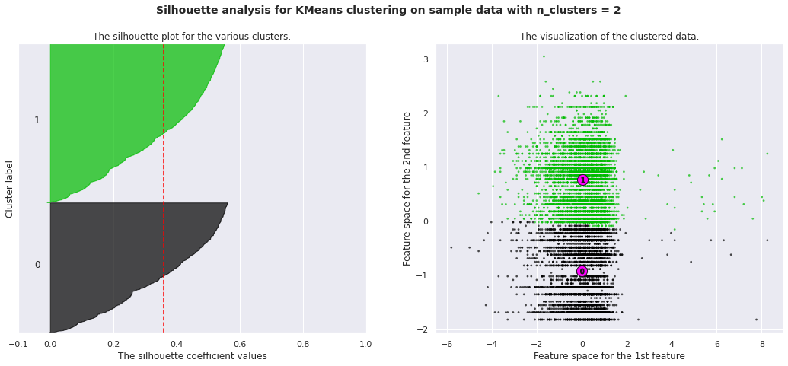
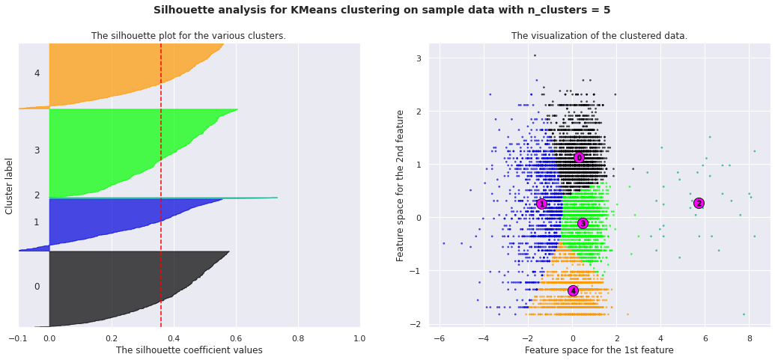
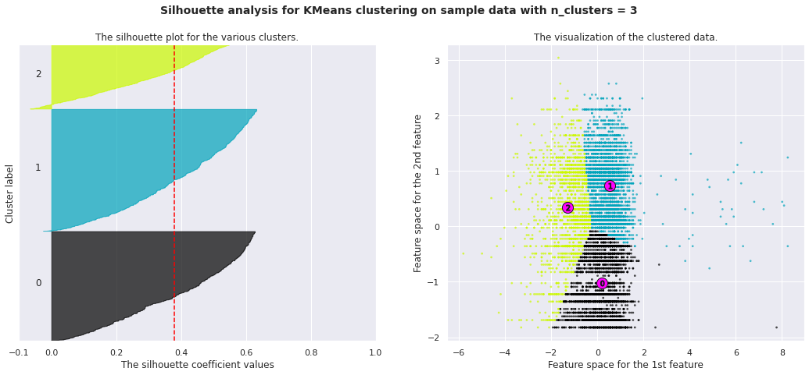
Model Implementation
3. k-means clustering

Slide 23
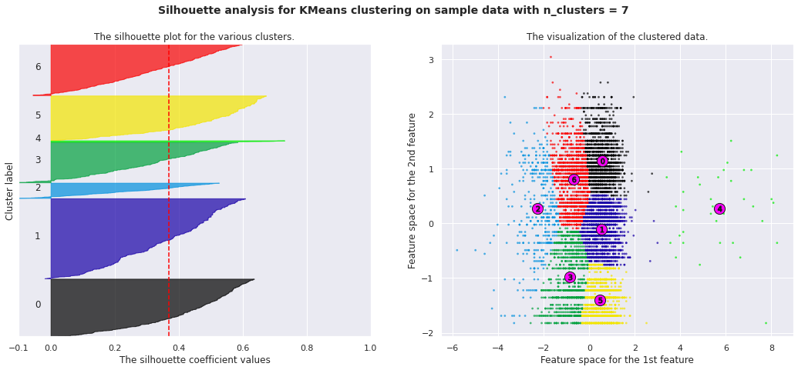
Model Implementation
3. k-means clustering
Here is the Silhouette analysis done on the above plots to select an optimal value for n_clusters.
The value of 6 and 7 for n_clusters looks to be the optimal one. The silhouette score for each cluster is above average silhouette scores.
For n_clusters = 2 The average silhouette_score is 0.3601761941410064
For n_clusters = 3 The average silhouette_score is : 0.3786424530063482
For n_clusters = 4 The average silhouette_score is : 0.34764733391208535
For n_clusters = 5 The average silhouette_score is 0.35819475414428864
For n_clusters = 6 The average silhouette_score is 0.36830181782871185
For n_clusters = 7 The average silhouette_score is 0.36688539987717955

Slide 24

Conclusion
Netflix has 5372 movies and 2398 TV shows, there are more number movies on Netflix than TV shows.
TV-MA has the highest number of ratings for tv shows i.e. adult ratings
Highest number of movies released in 2017 and 2018.
We saw a huge increase in the number of movies and television episodes after 2015.
There is a significant drop in the number of movies and television episodes produced after 2020.
It appears that Netflix has focused more attention on increasing Movie content that TV Shows. Movies have increased much more dramatically than TV shows.
India is the country having maximum numbers of movie on Netflix.
USA having maximum numbers of TV shows followed by India.
Those movies that have a rating of NC-17 have the longest average duration.
When it comes to movies having a TV-Y rating, they have the shortest runtime on average
October to January, maximum number of movies and TV shows were added.
The USA, India, the United Kingdom, Canada, and Egypt are the top five producer countries.
.

Slide 25

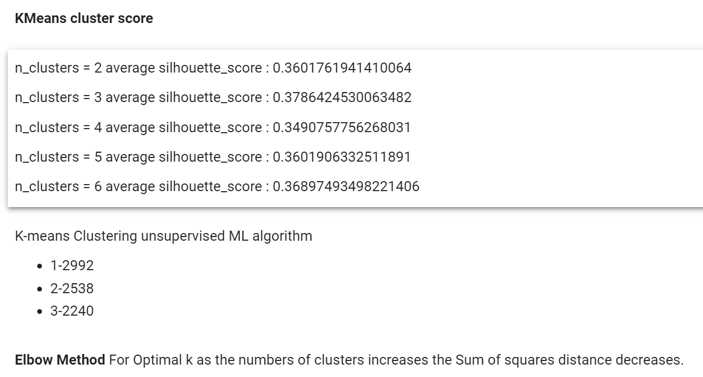
Conclusion
.

Slide 26


Slide 27

Time for Q&A!!

